Slide 1
Virtual Machines for use in PoC, development, tryout, workshop

Slide 2


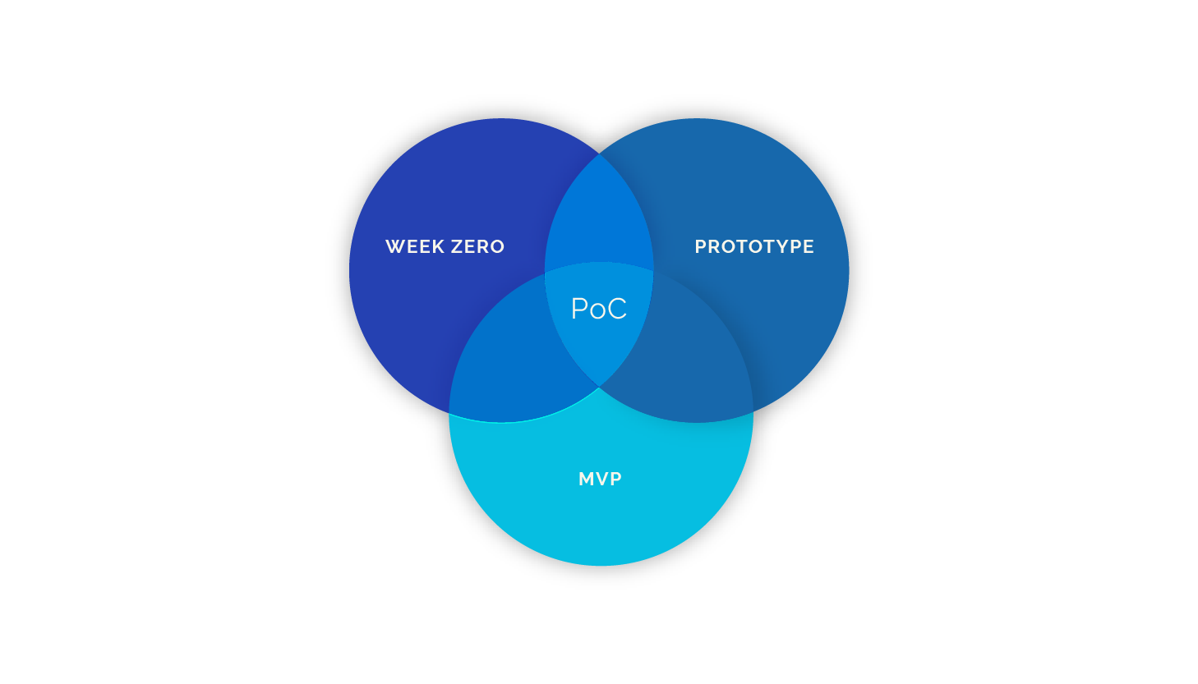
Virtual machines
Workshop Create a prepared environment for distribution
Study purposes Tryout new software or versions
PoC at a customer. Tryout new products

Slide 3


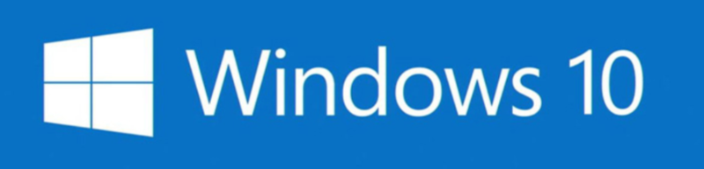
Prebuild VMs Why not use those?
Packaged Applications for Any Platform https://bitnami.com/
Oracle SOA Suite VM 12.2.1.3 https://www.oracle.com/technetwork/middleware/soasuite/learnmore/ vmsoa122130-4122735.html
Windows 10 VM https://developer.microsoft.com/en-us/windows/downloads/virtual-machines https://developer.microsoft.com/en-us/microsoft-edge/tools/vms/

Slide 4





Prebuild VMs
VS

Slide 5



Prebuild VMs Might not suit your specific needs
Not ready for distribution Often cannot be used as-is for workshops
Difficult to change (prebuild) You might want to add extra software
Usually fixed in configuration Network, disk

Slide 6



Creating your own VMs
It is more easy than you might think Using the proper tools
Provides flexibility without increasing complexity (much)
Independent of VM providers You’re in control!

Slide 7
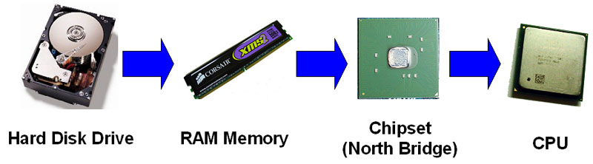

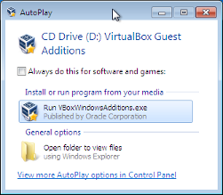
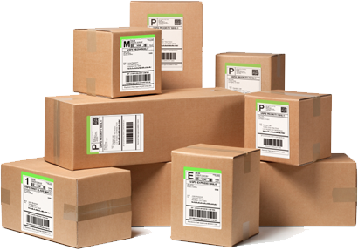

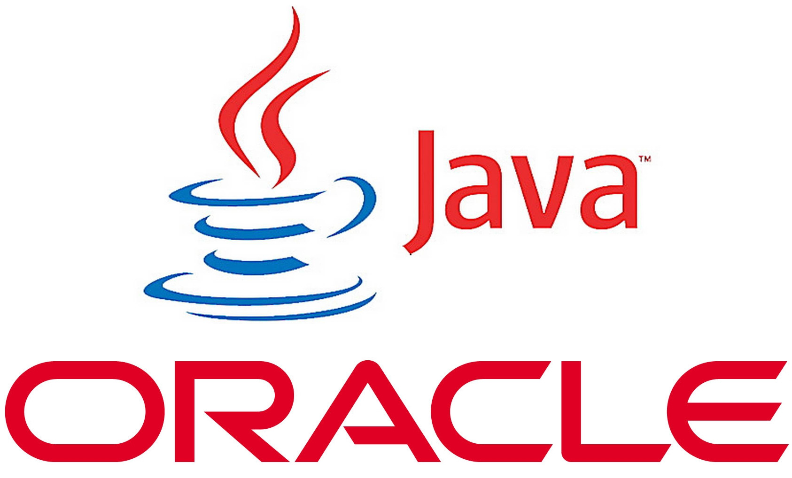
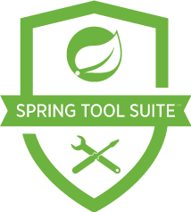

Creating your own VMs
Configure the virtual hardware Network interfaces, hard disk, memory, CPUs, …
Install the OS Partitioning, network configuration, guest additions
Provision the OS GUI, users, groups, packages, …
Install specific software Java, IDE, …

Slide 8


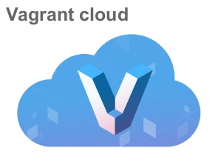
Creating your own VMs
Configure the virtual hardware Network interfaces, hard disk, memory, CPUs, …
Install the OS Partitioning, network configuration, guest additions
Provision the OS GUI, users, groups, packages, …
Install specific software Java, IDE, …
Vagrantfile
Kickstart Preseed
Template
Provision script

Slide 9
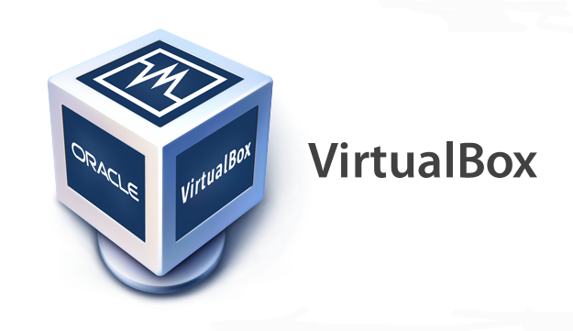
Creating your own VMs
OS ISO
Packer template file
Kickstart / Preseed file
VM base box
Vagrant file
Provisioning script
Ready to use VM

Slide 10
Creating your own VMs Kickstart
Unattended installations of Red Hat Linux based distro’s like Oracle Linux
Does everything the OS installer does Configure:
Language / locale
Keyboard / date time timezone
Network
Root user, create additional accounts
Configure partitioning
Configure initial packages

Slide 11
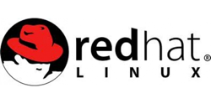


Creating your own VMs Kickstart: how does it work?
How to create a Kickstart file?
Perform a manual installation and grab the generated file
Use the Kickstart Configuration Tool (web based) from Red Hat
Kickstart Configurator (GUI) (no longer updated/maintained for RHEL 7 or after)
How to use a Kickstart file?
Create an installation medium containing the Kickstart file
Make it available on the network

Slide 12

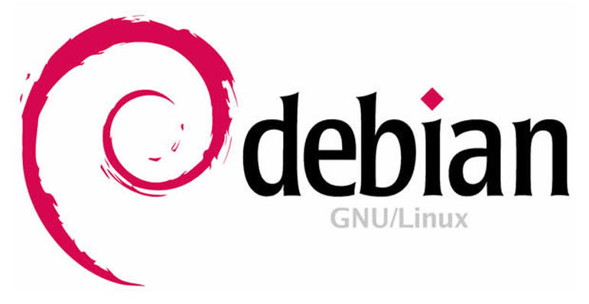
Creating your own VMs preseed
For Debian based distro’s like Ubuntu
Why not Kickstart?
Kickstart often cannot fully automate the Debian installation
Preseed provides all the options the Debian installer offers
Kickstart and Preseed can be used together
Why/when Ubuntu?
Ubuntu is
Developer friendly
Cutting edge features and tooling
RHEL + derivatives are (usually) better for production environments
Notes:
Using together as in for example using preseed commands from kickstart

Slide 13
packer
Helps create an image of a virtual machine. Supports many formats like Amazon, Azure, Docker, VirtualBox, …
Downloads or uses a local ISO file
Hosts and runs a Preseed or Kickstart file
Can run provisioners like shell scripts, Chef, Puppet
Can output a Vagrant base image
Packer is mostly suitable to create base images
Is limited in options for managing VM’s and configuring VM environments (like VirtualBox)

Slide 14
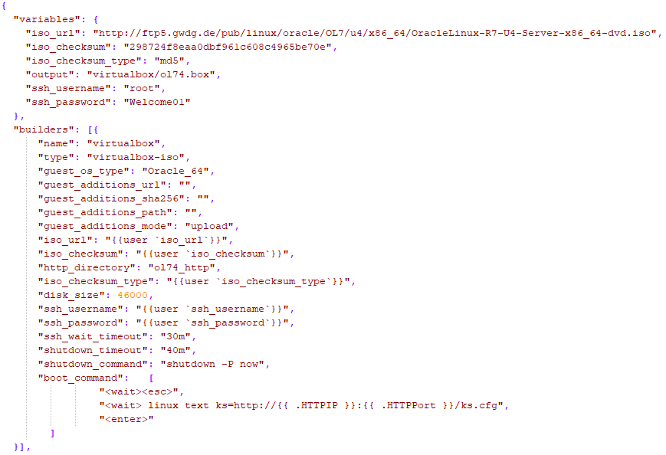
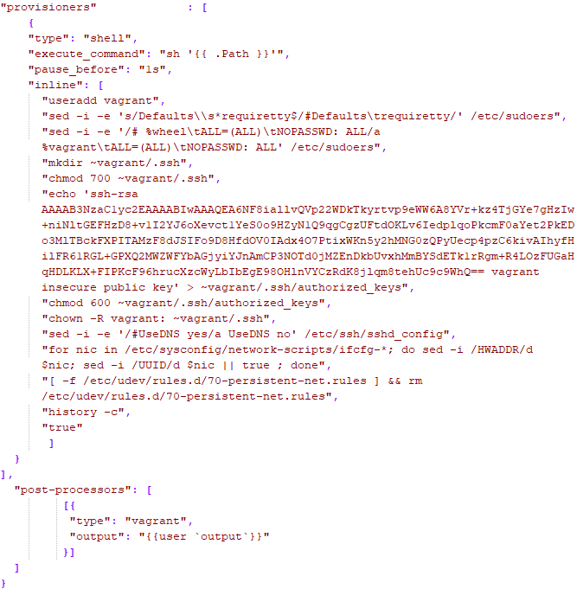
Packer How does it look?

Slide 15
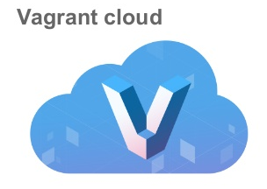
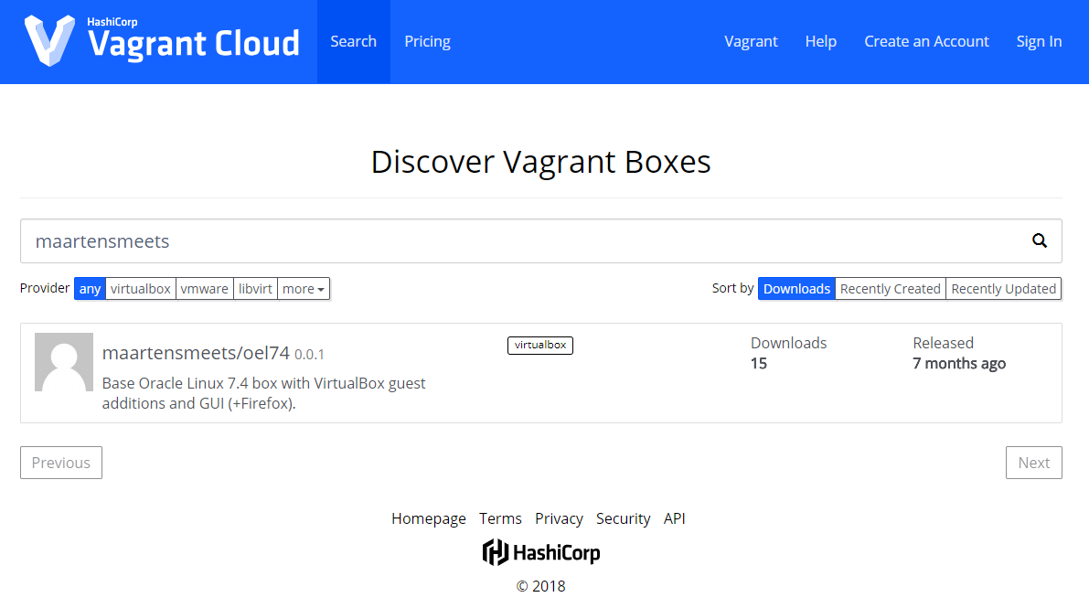

Slide 16
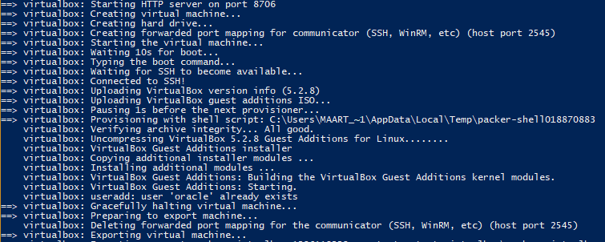

Slide 17
Workshop 1 introduction
VM base box
Vagrant file
Provisioning script
Ready to use VM

Slide 18
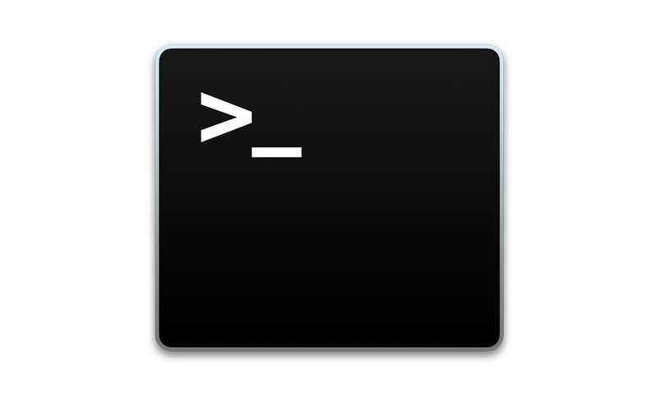
Workshop 1 introduction. Automation Topics covered
Create your VirtualBox VM using a Vagrantfile
Install guest additions, install Docker, resize the disk, configure memory, CPU
Create a provision script
Install packages, create users, install Java
Install Spring Tool Suite and Kafka in Docker
GUI from container, Docker networking

Slide 19
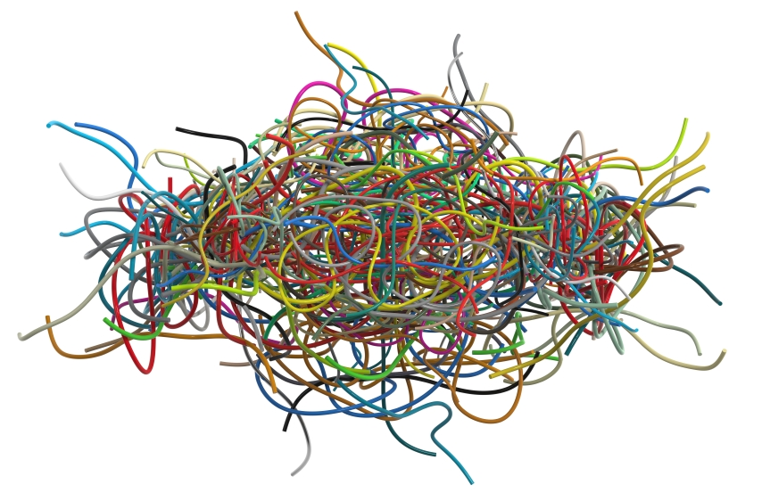

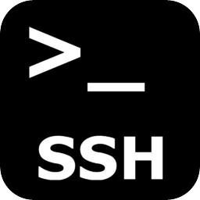
Workshop 1 introduction: Automation What helps Vagrant you with?
Automates creation and configuration of the VM
Removes complexity of (OS specific)
Installing guest additions
Configuration of network scripts
Resizing the disk
Installation of Docker and docker-compose
Easily remove and recreate your VM
vagrant destroy (and it’s gone)
vagrant up (and it’s there again)
Easily connect to your VM using SSH
vagrant ssh
Notes:
Of course much more such as abstraction of VM configuration. Instead of VirtualBox you can create different types of images

Slide 20
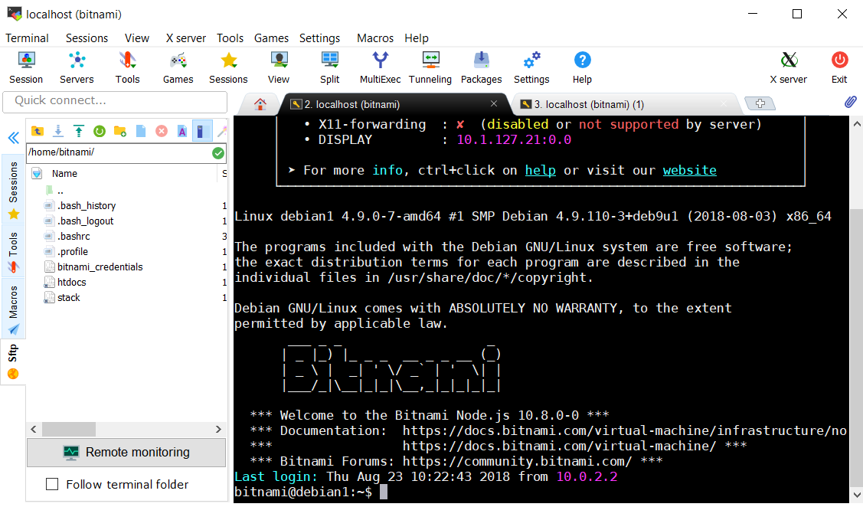
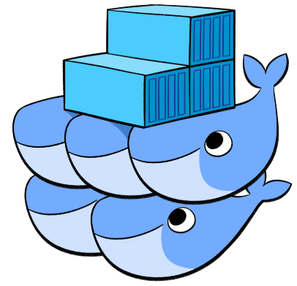
Workshop 2 introduction. Networking Topics covered
Use a prebuild VM from Bitnami
VirtualBox
Configure a NAT network
Create port mappings
Cloning a VM, networking implications
Use external tools to connect to the VM
Connectivity testing
Create a Docker overlay network and use it with Docker Swarm

Slide 21
Workshop links
Workshop 1: Automation
http://bit.ly/VagrantDockerSpringBootWorkshop Vagrant, Docker, Spring Boot. Focus on automation
Workshop 2: Networking
http://bit.ly/DockerVirtualBoxNetworkingWorkshop Bitnami, VirtualBox, Docker. Focus on networking

